Slide 1

Intelligent Waste Management Vision based multi-class segmentation with robotic manipulator and LLM-driven waste processing insights
Team – D03
Naren Sundar L – CB.SC.U4AIE23322
Renny Harlin D – CB.SC.U4AIE23334
Vatturu Pardheev – CB.SC.U4AIE23344
Charuvarthan T – CB.SC.U4AIE23359

Slide 2
Introduction
Waste management struggles with inefficiency and pollution.
Manual sorting is slow, error-prone, and hazardous.
Automation improves efficiency and recycling.

Slide 3
Objectives
Automate waste classification using Robotics and AI
Enhance waste based segregation using vision based segmentation model
Implement robotic manipulator for waste disposal

Slide 4
Challenges faced
Transforming object coordinates from camera coordinate frame to the arm coordinate frame
Transforming the bounding box coordinates from the vision transformer to camera coordinate frame
Automating the workflow of pick and drop based on the response from the vision model

Slide 5
Literature Review
S.No | Authors | Year | Title | Observation
1. | W. Liu et al. | 2016 | SSD: Single Shot MultiBox Detector | Introduced a single-shot object detection method using a series of convolutional layers to predict object categories and bounding boxes at multiple scales.
2. | J. Redmon et al. | 2016 | You Only Look Once: Unified, Real-Time Object Detection | Introduced YOLO, a single neural network which predicts object class and location in a single pass, significantly improving detection speed.
3. | Z. Jin and P. Pagilla | 2018 | Collaborative Operation of Robotic Manipulators with Human Intent Prediction and Shared Control | Developed a system where robotic manipulators use sensor data and machine learning to predict human intent, enabling shared human-robot control.

Slide 6
S.No | Authors | Year | Title | Observation
4. | Y.-M. Chang, C.-H. Li, and Y-F. Hong | 2019 | Real-Time Object Coordinate Detection and Manipulator Control Using Rigidly Trained Convolutional Neural Networks | Visual-position control scheme that employs convolutional neural networks (ConvNets) trained with rigid 3D coordinate information
5. | J. Bai et al. | 2020 | Deep Learning Based Robot for Automatically Picking Up Garbage on the Grass | Developed a robot equipped with a deep neural network for garbage recognition and ground segmentation.
6. | J. Liu et al. | 2021 | Garbage Collection and Sorting with a Mobile Manipulator using Deep Learning and Whole-Body Control | Combining deep learning with whole-body control to enable effective autonomous garbage collection and sorting.
7. | B. Yan et al. | 2021 | A Real-Time Apple Targets Detection Method for Picking Robot Based on Improved YOLOv5 | Enhanced the YOLOv5 algorithm to improve real-time detection of apples in orchards by optimizing the network structure.

Slide 7
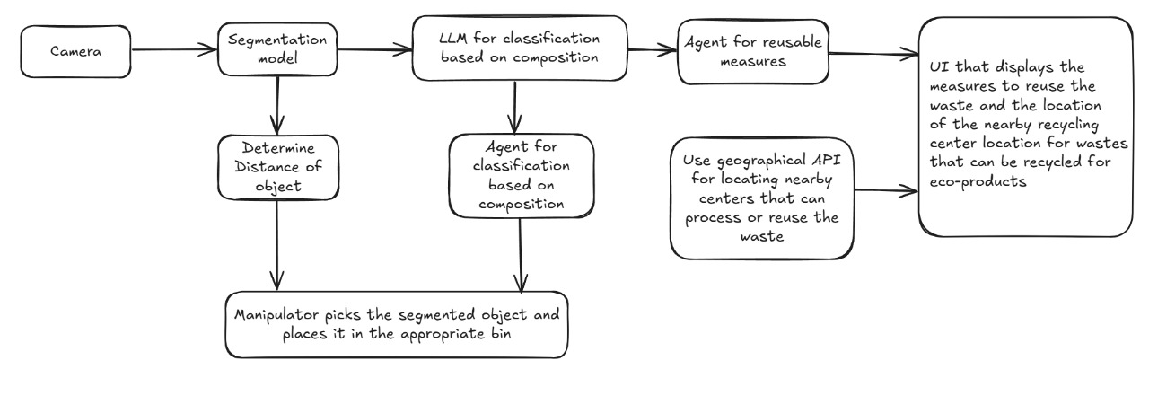
Methodology

Slide 8
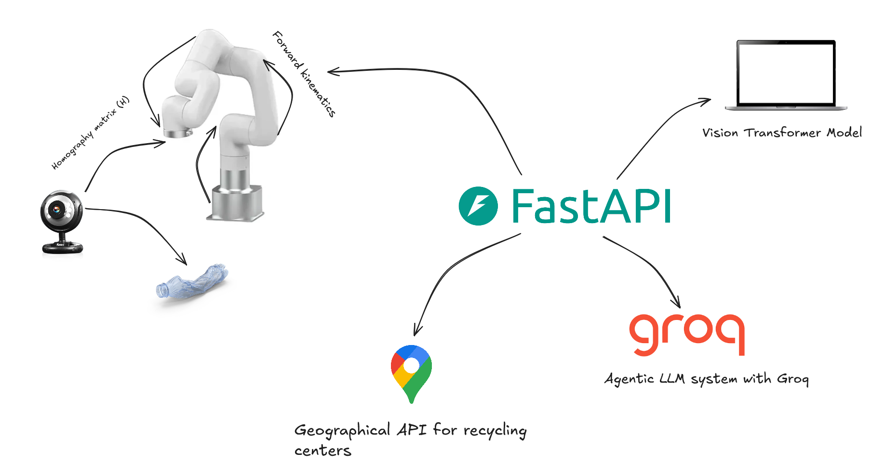
System Architecture

Slide 9
Vision Models
For object detection and segmentation
Transfer learning on Yolo v8
Object detection using Single Short Multibox Detection
Object detection using Vision Transformers

Slide 10
Vision Transformers
Vision Transformers use self-attention mechanisms to process images efficiently, capturing global dependencies.
They divide images into patches and analyze global relationships, improving feature extraction.
Each patch is embedded with positional encoding and passed through a transformer encoder.
The final output is processed by a classifier for tasks like object detection or segmentation.

Slide 11
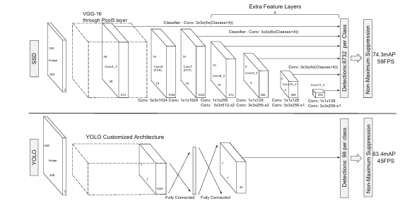
Model Architectures

Slide 12
Single Short Multibox Detector (SSD)
Model | Complexity | Speed | Efficiency | Accuracy | FPS
Yolo v8 | Medium | Fast | Efficient | Medium | 45
SSD | Low | Fast | Efficient | High | 59

Slide 13
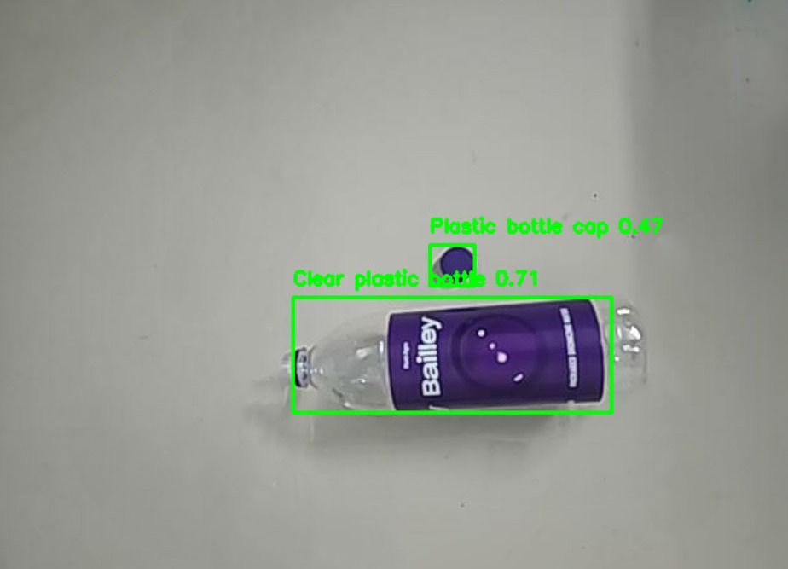
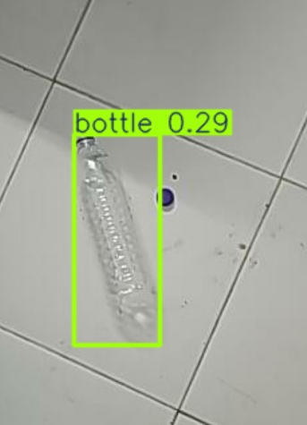
Default vs Finetuned Yolo v8
Finetuned model
Default model

Slide 14
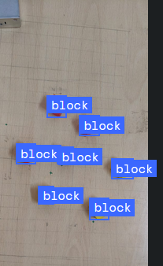
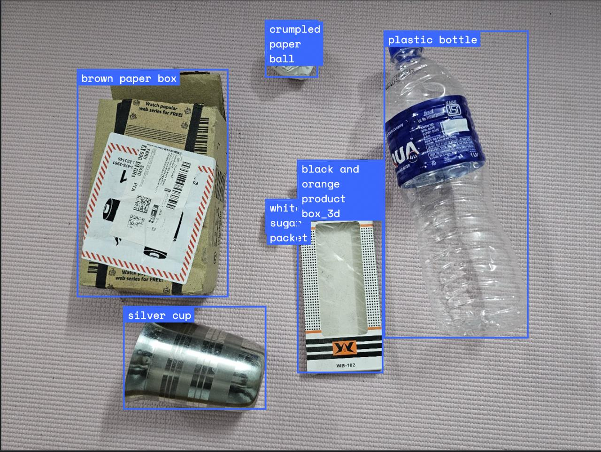
Vision Transformers
Finetuned model

Slide 15
Relevance in MFC-4
Forward kinematics
Homography matrix
Singularity analysis using the Jacobian matrix

Slide 16
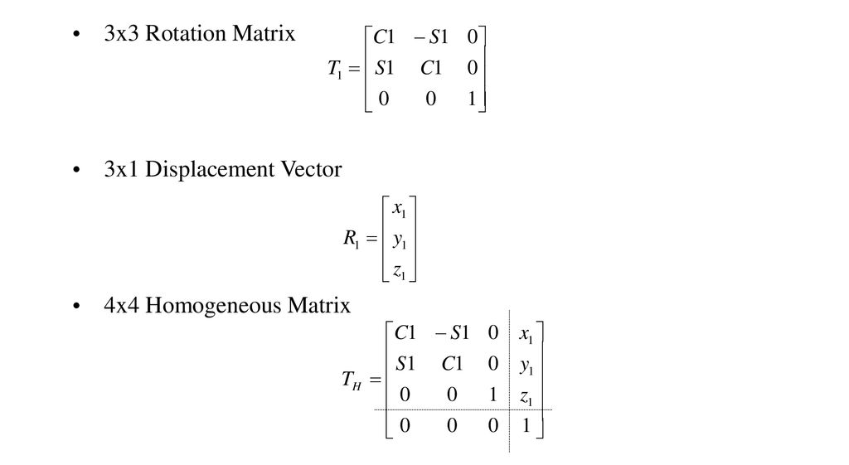
Homogeneous Transformation Matrix

Slide 17
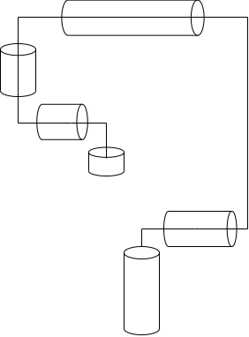
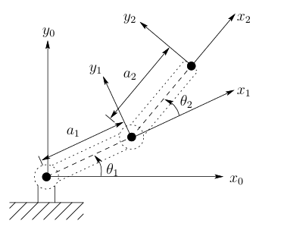
Forward Kinematics
Given the joint angles, forward kinematics gives the position of end effector in terms of a Homogeneous transform matrix

Slide 18
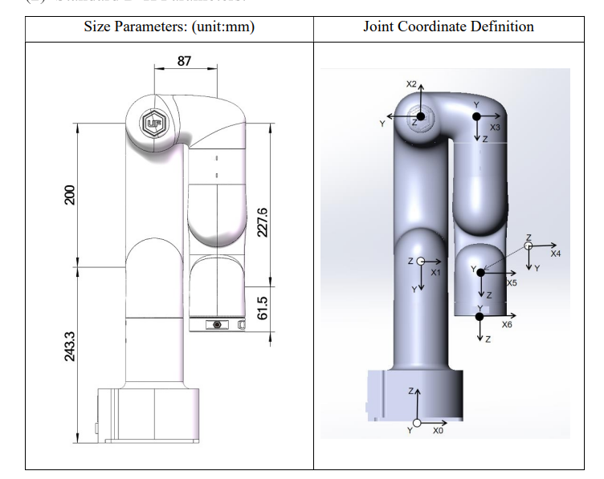
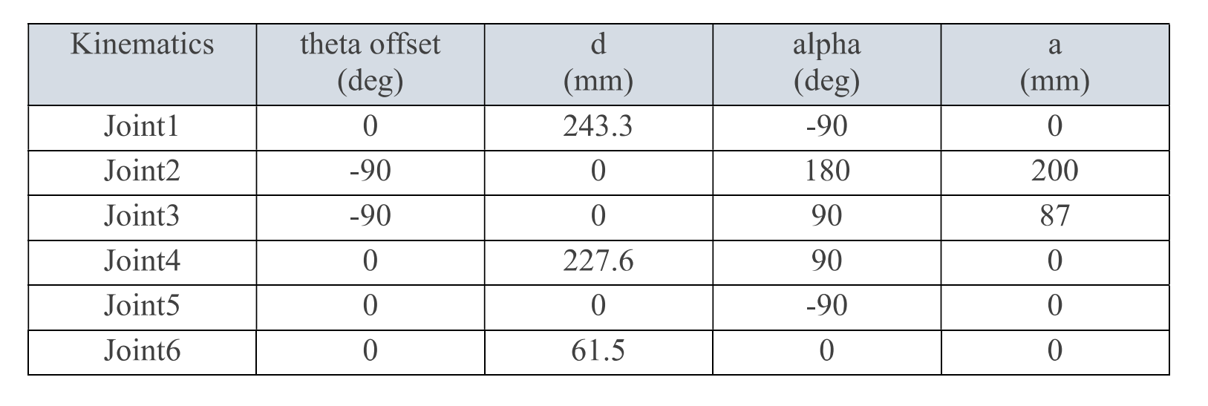
Forward Kinematics

Slide 19
Inverse Kinematics
Given the end effector position, inverse kinematics tells us the joint angles
The Denavit-Hartenberg representation gives both the transformation for forward and inverse kinematics
Manipulator to be used:
Ufactory Lite 6 (6-DOF manipulator)

Slide 20
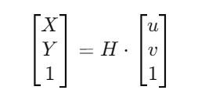
Transformation from camera coordinate frame to end-effector coordinate frame
Camera coordinate frame gives us the pixel coordinates of the object in the X-Y plane
In order to move the arm to the particular object, the location with respect to the arm coordinate system is needed
We introduce a transformation matrix (H) that transforms the pixel coordinate frame to the arm coordinate frame
where (u, v) vector is the pixel coordinates

Slide 21
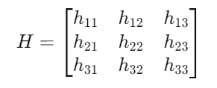
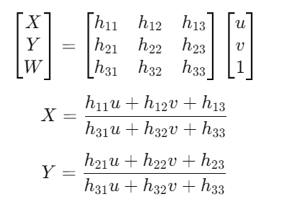
Homography Matrix
Homography matrix is a 2-D transform matrix

Slide 22
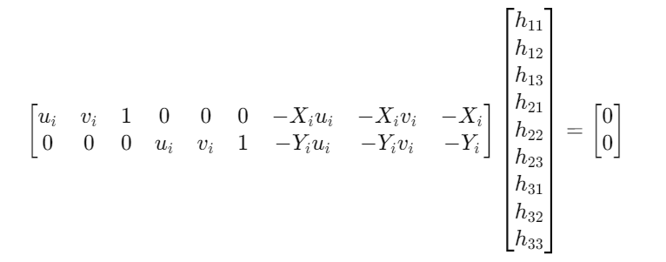
Homography Matrix
Finding homography matrix
For one point we get 2 equations, so sampling at 4 points will be sufficient to find the optimal solution

Slide 23
Future Work
Automate picking tasks based on the output from the vision model
Use agentic AI to give insights about the composition of the particular object
UI for displaying all results processed in the FastAPI server

Slide 24
Timeline
1st Review
February
2nd Review
March
Task | 1 | 2 | 3 | 4 | 5 | 6 | 7 | 8 | 9 | 10 | 11
Literature review and problem statement formulation
Hardware and software selection for the system
Vision model and Transfer Learning
Integrating camera with Ufactory Lite 6 arm
Extracting pixel values using openCV
Mapping Pixel Coordinates with Real World coordinates
Integrating Vision Transformers into the work flow
Integrating LLMs in to the workflow to have deeper insights about the composition of waste
UI to display waste classified and the ways it can be reused or disposed based on composition
Overall review of edge cases and identifying drawbacks in the system and singularity analysis

